Slide 6
Module 1 - Introduction to Python 3
1: Introduction to Python 3
2: Fundamental Variables
3: Flow Control

Slide 7

Contents
What is Python?
Python Versions & Implementations
Why use Python?
Zen of Python
Python Performance
Python Community
Interacting with a Python
Command line
IDEs
Scripts
Python Help and PEP
Anatomy of a Python Script
Modules, Functions and built-ins
Summary
Notes:
This chapter introduces Python 3 and explores why Python continues to be one of the most popular programming languages. We'll look at its key benefits and the 19 guiding principles—known as the Zen of Python—that shape the language's design.
Python is a general-purpose, object-oriented scripting language with multiple interfaces, including user-friendly web-based environments like Jupyter Notebooks. As an extensible language, it supports a wide range of libraries and modules, making it ideal for developing fast and efficient solutions.
We'll focus on the basics in this chapter—but that’s all you need to start your Python journey.

Slide 8
By the end of this chapter, you will be able to:
Describe what Python is and why it’s widely used
Compare Python versions and popular implementations
Understand the philosophy behind Python via the Zen of Python
Discuss Python’s performance and community support
Run Python interactively, via scripts, or through IDEs
Access help, use PEPs, and explore built-in documentation
Understand the structure of a Python script
Use modules, functions, and built-in features effectively
Notes:
This chapter introduces Python 3 and explores why Python continues to be one of the most popular programming languages. We'll look at its key benefits and the 19 guiding principles—known as the Zen of Python—that shape the language's design.
Python is a general-purpose, object-oriented scripting language with multiple interfaces, including user-friendly web-based environments like Jupyter Notebooks. As an extensible language, it supports a wide range of libraries and modules, making it ideal for developing fast and efficient solutions.
We'll focus on the basics in this chapter—but that’s all you need to start your Python journey.

Slide 9
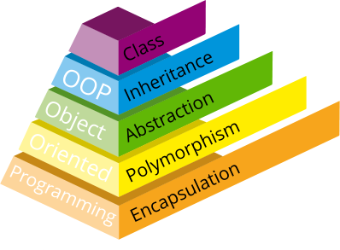
What is Python?
Python is an object-oriented scripting language
First published in 1991 by Guido van Rossum
Designed as an OOP language from day one
Does not need knowledge of OO to use
It is powerful
General purpose, fully functional, rich
Many extension modules
It is free
Open source: Python license is less restrictive than GPL
It is portable
UNIX, Linux, Windows, OS X, Android, etc…
Ported to the Java and .NET virtual machines
O O P
Object
Oriented
Programming
Notes:
Python is a clean, object-oriented scripting language designed for readability and ease of use. It was originally developed by Guido van Rossum in the late 1980s and has since evolved through contributions from a large global community.
The name "Python" doesn't come from the snake, but rather from Monty Python’s Flying Circus, a British comedy series that van Rossum enjoyed. This light-hearted and playful origin reflects the language’s emphasis on simplicity and fun.
While Python 2 was copyrighted by BeOpen.com and Stichting Mathematisch Centrum in Amsterdam, Python 3 is maintained and copyrighted by the Python Software Foundation (founded in 2001). Python is free and open source, but it is not controlled by the Free Software Foundation and does not include any GNU code, although it is GPL-compatible and can interface with GNU components if needed.
Useful links:
🔗 Python: http://www.python.org
🔗 Jython: http://www.jython.org
🔗 IronPython: http://www.codeplex.com/Wiki/View.aspx?ProjectName=IronPython

Slide 10
Python Versions
Python 3 was released in December 2008
Also known as Python 3000 or Py3k
New version of the language
Not backward compatible with Python 2
2to3.py tool distributed from Python 2.6 and 3.n
Most language features are the same
Some detail has changed
Syntax cleaned up
Many deprecated features have been removed
Notes:
The most noticeable change in Python 3 is that print is no longer a statement—it's now a built-in function. This means parentheses are required, e.g., print("Hello"). For those familiar with Python 2, this can take some getting used to.
While some Python 3 scripts may run on Python 2.6+, and vice versa, this is purely coincidental and should not be relied upon. Compatibility is not guaranteed.
From version 2.6 onward, many Python 3 features were backported into Python 2. Tools like the -3 warning flag and the 2to3.py conversion utility were introduced to ease the transition. However, Python 2 reached end-of-life with the final release of 2.7 on July 4, 2010. Maintenance officially ended in 2019.
Guido van Rossum, Python’s creator, stated - “If you're starting a brand-new thing, you should use 3.0.”
That said, due to performance concerns, Python 3.0 was short-lived, quickly replaced by version 3.1 within months. Python 3 is now the standard.
The king is dead. Long live the king!

Slide 11

Python Implementations
Several Variants of Python
Most common is written in C and known as CPython
Java based version named Jython
C# (.Net) based version named Iron Python
Python based version: PyPy
Just-in-time compiler, fewer threading issues
Remarkable performance improvements x3
Latest version is v7.3.10 (Python 3.10)
Might be the default Python one day
Platform Agnostic
No platform specific functions in the base language
Greater portability for applications
Notes:
There are several versions of Python, each differing in subtle ways. The most widely used—and the one assumed for this course—is CPython. Written in C for speed and portability, CPython runs on many platforms. You can even download and compile the source code yourself. The latest version is 3.13.3 (as of April 2025).
The Java-based implementation, Jython, uses Java’s native services and is well-suited for integrating with Java systems, as it can directly use Java classes. However, Jython has not yet released a version compatible with Python 3.
IronPython serves a similar role for .NET environments. Its latest stable version is 3.4.2, compatible with Python 3.4, and targets .NET Framework 4.6.2, .NET Core 3.1, and .NET 6.
All these implementations—CPython included—have active developer communities that share ideas and occasionally even code. A pure Python virtual machine, PyPy, is also under development, and other VMs have benefited from its innovations.
Python isolates platform-specific features in the os module, which is deliberately non-portable. Despite this, cross-platform compatibility is never fully guaranteed—differences like filename syntax still vary between UNIX, Windows, and macOS.

Slide 12
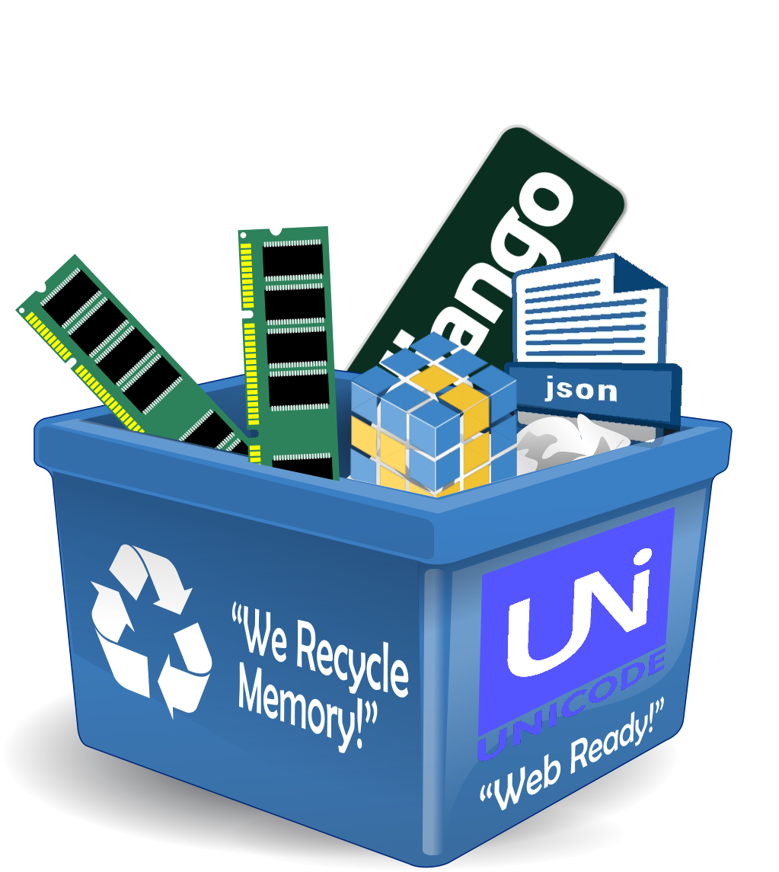
Why use Python?
Power
Garbage collector
Native Unicode objects
Supports many component libraries
GUI libraries such as wxPython and PyQt
Scientific libraries such as NumPy, DISLIN, SciPy, etc.
Mature JSON support
Web template systems such as Jinja2, Mako, etc.
Web frameworks such as Django, Pyjamas, and Zope
Relational Databases support
Libraries may be coded in C or C++
Notes:
Like most modern languages, Python has a garbage collector—so we don’t need to worry too much about memory management. Unicode refers to multi-byte character sets, essential for displaying international characters, the Euro symbol (€), and even emojis. It supports virtually every human language, making Python web-ready and globally compatible.
One of the strengths of community-driven projects like Python is the wide range of free add-on libraries. These include powerful tools like NumPy for numerical computing and DISLIN for data visualization.
Python also has strong support for JSON (JavaScript Object Notation), widely used in web development as a lightweight alternative to XML. Many web frameworks and APIs—such as those for Twitter—rely heavily on JSON.
These add-ons are possible thanks to Python’s ability to interface with C. Most APIs are designed in C, and Python can use C-written libraries. To integrate third-party software, developers often create a C-Python wrapper around it.

Slide 13
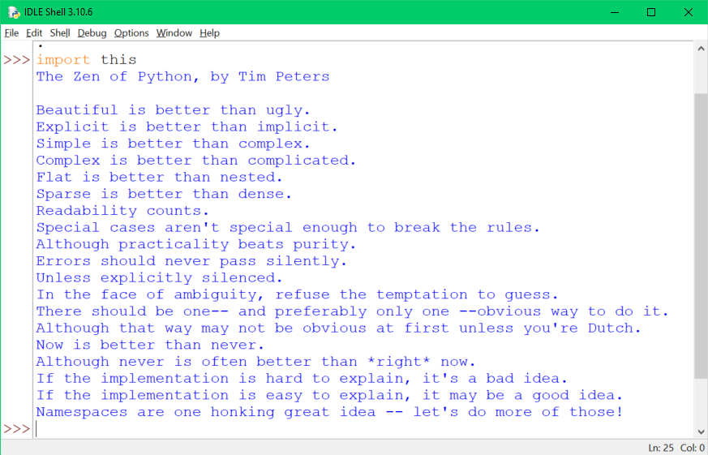

Zen of Python
19 Guiding Principles
…and some entertainment
pygame – set of libraries for writing games​
Many games use Python as a scripting language​
A fun way to learn
Notes:
It would be remiss not to mention the this module—a playful Easter egg that reveals 19 guiding principles by Tim Peters, known as The Zen of Python. These principles offer insight into the philosophy that shapes the Python language.
To view them, try this at the IDLE prompt:
>>> import this
For some light-hearted fun, consider downloading Pygame and diving into classics like Flappy Bird, Super Potato Bruh, Sudoku, and of course, Snake! You can even create your own games.
Visit www.pygame.org — “Takes the C++ out of Game Development.”

Slide 14
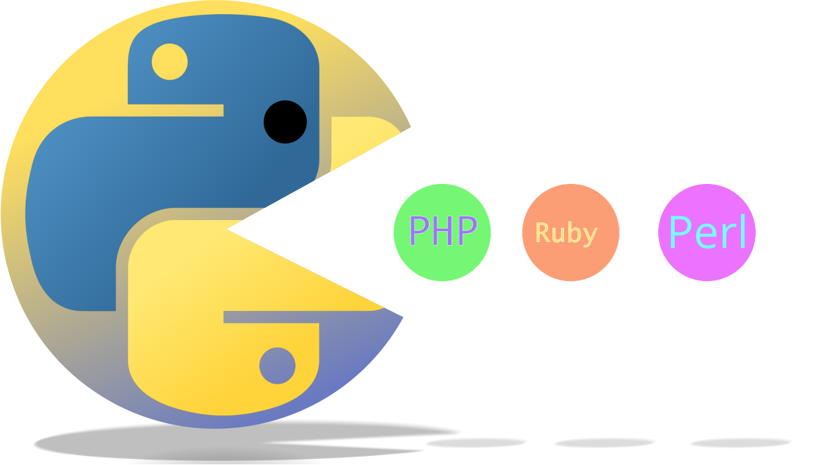
Python Performance
Performance
Python programs are compiled at runtime into ‘byte code’
Byte code does not compile down to PE or ELF
Cannot be a fast as well written C
Worse CPU usage than Java and C# on most benchmarks
But…
Better memory management
Equivalent to Perl and Ruby - depending on the benchmark
Better than PHP and better than Tcl
Packages often use compiled extensions
Google Unladen Swallow project improved the base
Notes:
Like many scripting languages—such as Java, C#, Perl, Ruby, and PHP—Python is compiled at runtime into an internal format known as bytecode. It’s unrealistic to expect this to match the speed of C programs compiled into native executables like PE COFF (on Windows) or ELF (on UNIX). Nevertheless, some impressive benchmarks show that Python’s performance can be surprisingly competitive in certain scenarios.
It’s also worth noting that writing fast, safe, and efficient C code requires significant expertise, whereas Python enables safer code development with less effort and faster turnaround. As we’ll see later, Python modules are usually compiled into bytecode only once and then stored—though this bytecode is not portable across systems. You can find more benchmark information at:
http://shootout.alioth.debian.org/gp4/python.php
IronPython and Jython generally perform similarly to CPython, and all of these VM implementations are under continuous development with ongoing optimizations. Unladen Swallow project, named after a famous line from Monty Python and the Holy Grail, was merged into the mainline and contributed to performance enhancements (see PEP 3146).

Slide 15
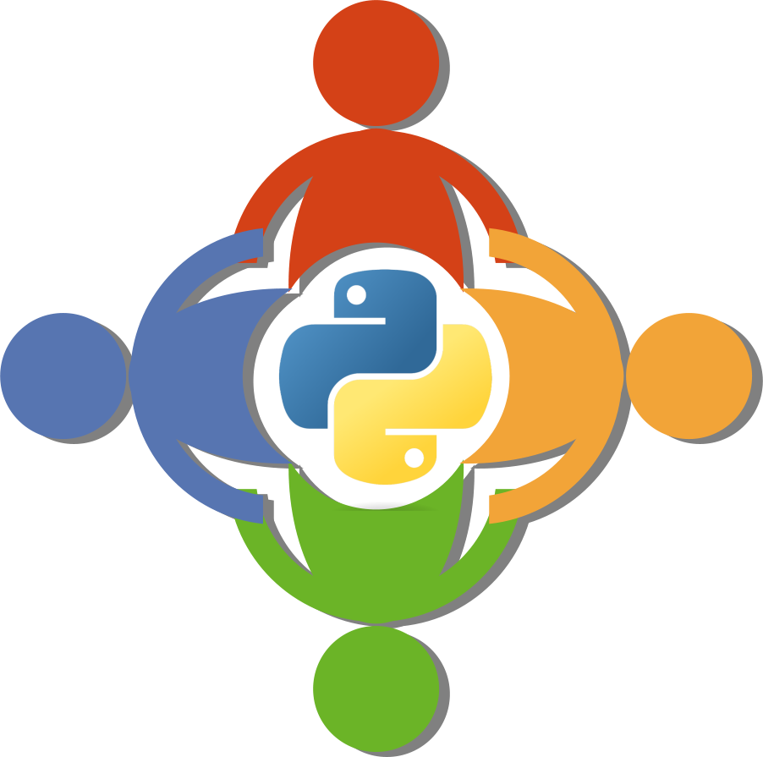
Python Community
Python Software Foundation (PSF)
Holds the Python intellectual property rights
The stating point: www.python.org
Many newsgroups and forums
Main download and docs: https://python.org
Main newsgroup for Python users: comp.lang.python
Web forum: python-forum.org/pythonforum/index.php
Blog: http://planet.python.org/
Python Conference & Interest Groups
PyCon - EuroPython moves around European cities
U.S.A. - PIGgies
Notes:
The Python Software Foundation (PSF) website is the go-to starting point for anything related to Python. It offers a wealth of resources, including downloads, tutorials, documentation, and a wide range of modules.
Python enthusiasts gather at various conferences held around the world each year, including EuroPython and PyCon. You can find details about these events via the python.org website.
Please note that “Python” and the Python logo are registered trademarks of the Python Software Foundation.

Slide 16
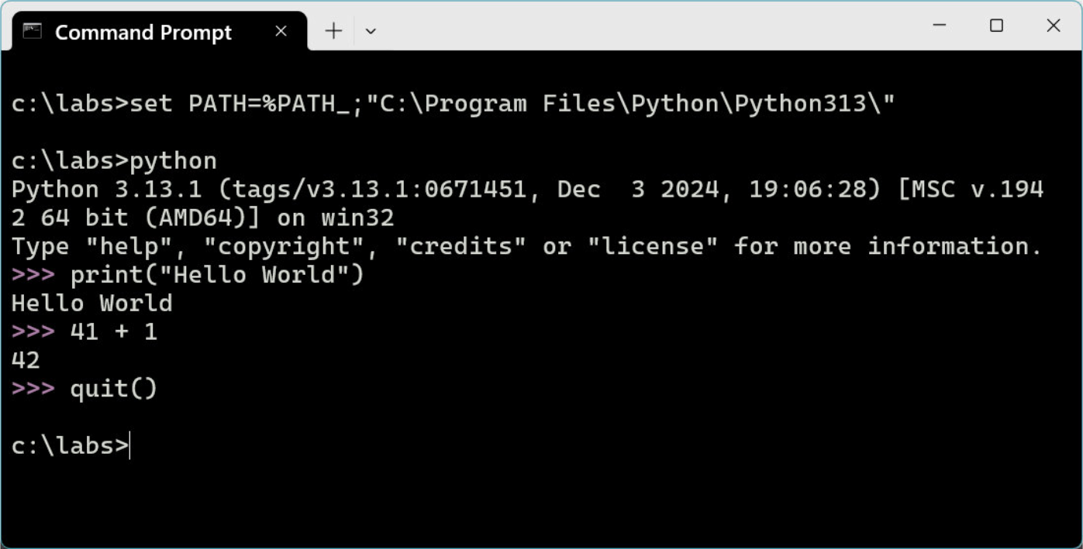
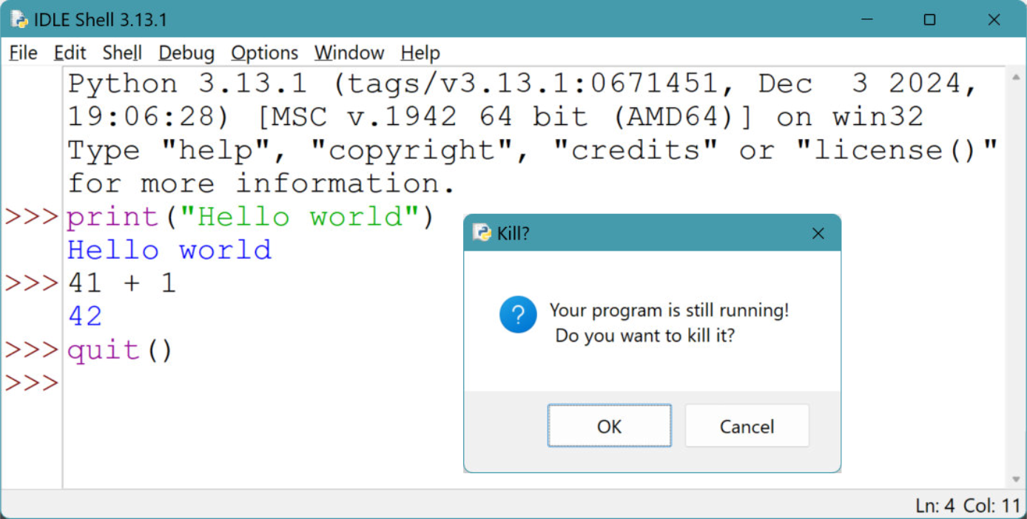
Interacting with a Python Session
Command Line
Interactive
Available in Windows and Linux Shell
Limited Debugging
Interactive help() and documentation
IDLE – Integrated Development Learning Environment
Graphical, Interactive and portable
Limited debugging features
Interactive help() and documentation
Built-in text editor with syntax highlighting
Command History – Previous=Alt-p and Next=Alt-n
Notes:
When Python is launched interactively from a shell—whether it’s a UNIX-style shell like Bash or the Korn shell, or Microsoft’s cmd.exe—you’re presented with the Python shell prompt: >>>. This is often called the REPL prompt, which stands for Read, Evaluate, Print, Loop. It allows you to quickly test or evaluate Python code before incorporating it into a script.
The REPL continues running until you call the exit() or quit() functions, or press <CTRL+Z> on Windows or <CTRL+D> on UNIX/Linux systems.
One of the most useful initial commands is the built-in help() function, which provides interactive documentation and guidance. Python can be configured using optional environment variables, though these are rarely needed. Full details can be found in the official documentation.
IDLE is a simple GUI for writing and debugging Python code. It comes bundled with Python and is handy for development. (And yes—Eric would approve: “Nudge nudge, wink wink, say no more!”). Note that IDLE may encounter issues with personal firewalls. On Linux, it also requires Tk to be installed.
On macOS, IDLE controls differ slightly:
<CTRL+P> – Previous statements
<CTRL+N> – Next statements

Slide 17
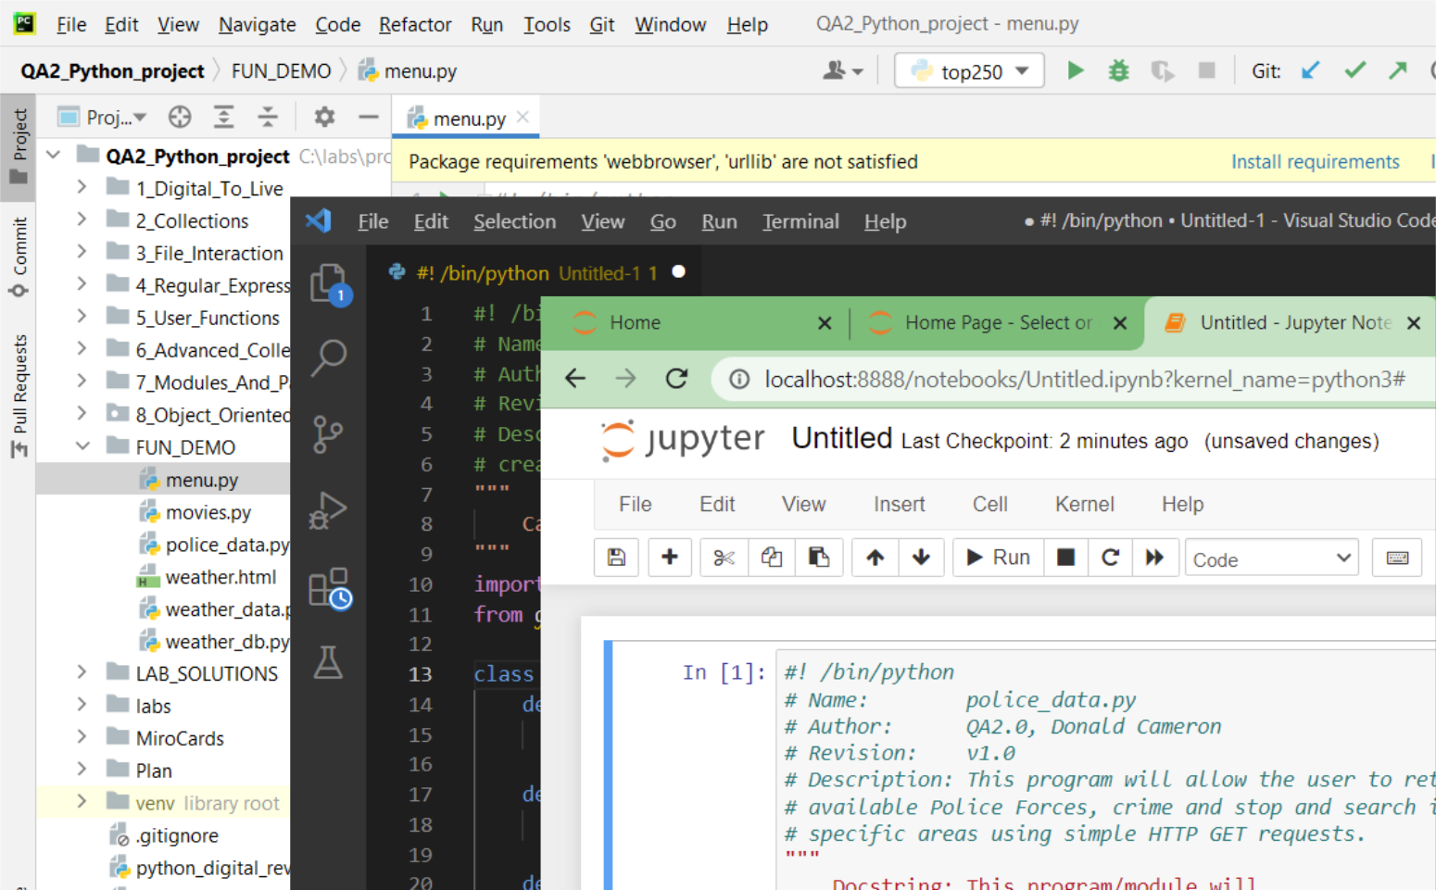
IDEs – You have a choice!
Integrate Development Environments
IDLE, Pycharm, VSCode, Eclipse..
User Friendly GUI
Built-in text editor and debugger
Integrated console
Coloured Coded highlighting
Code Search
Integrate with Online Repository and CI/CD
Web Based IDE – Jupyter Notebooks
Supports 100+ languages
Suited for Data Science and Maccine Learning
Notes:
The Python REPL prompt and IDLE are basic interfaces with limited functionality.
Even beginner Pythonistas often transition quickly to more feature-rich IDEs such as PyCharm or VS Code. These environments offer powerful editors, integrated consoles, advanced debugging tools, and seamless integration with version control systems and online repositories like GitHub and Bitbucket.
Additionally, web-based interfaces such as Jupyter Notebooks are popular—particularly within the data science community—for their ability to combine code, visualisations, and narrative text in a single interactive document.

Slide 18
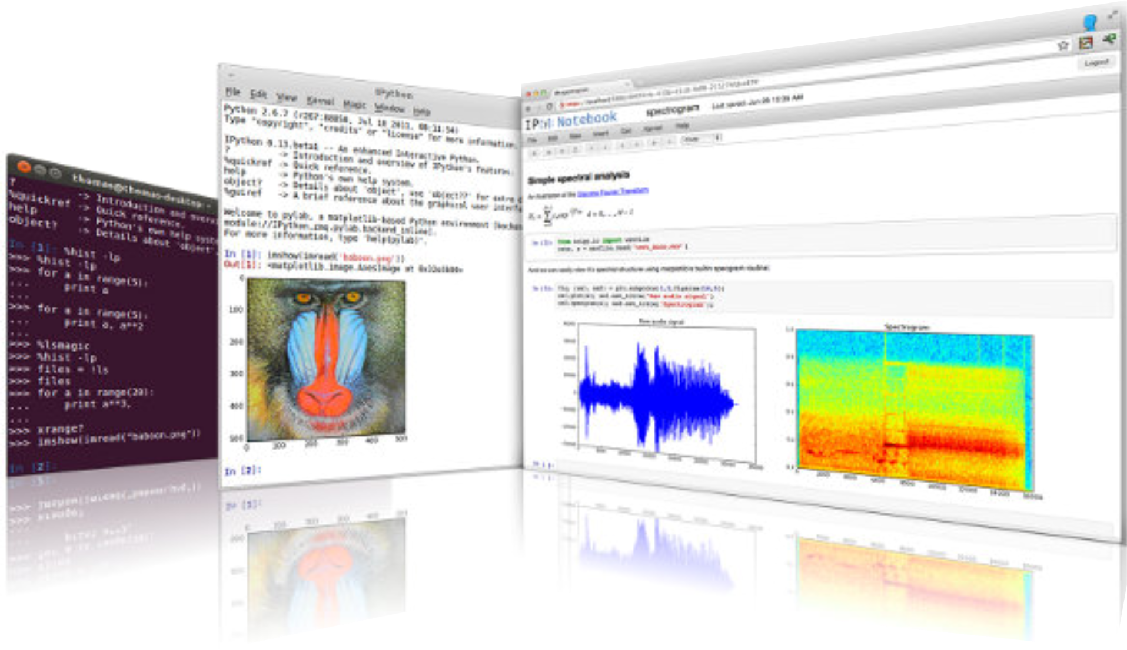
IDEs - IPython and Jupyter
Interactive Computing and Data Visualisation
Jupyter Notebooks – fork of IPython (2014)
Named dericed from Julia, Python and R
Computational notebook for Literate Programming
Donald Knuth
“Instead of imagining that our main task is to instruct a computer what to do, let us concentrate rather on explaining to human beings what we want a computer to do.” – Donald Knuth
Notes:
IPython, or Interactive Python, is a powerful command-line shell designed for interactive computing. It supports introspection (examining object types and properties), rich media (text, images, graphs), shell syntax, tab completion, and command history.
IPython also offers a browser-based notebook interface that allows the integration of code, text, mathematical expressions, and interactive data visualisations such as plots. It’s widely used alongside math and data science libraries like NumPy, SciPy, and matplotlib.
In 2014, IPython creator Fernando Pérez launched a spin-off project: Project Jupyter. IPython now functions as the kernel and shell within Jupyter’s notebook-style interface. Jupyter is language-agnostic, and its name reflects the core languages it originally supported: Julia, Python, and R.
As a result, the Jupyter Notebook (formerly the IPython Notebook) has become a web-based, interactive environment for writing, running, and visualising code. It supports over 100 kernels, with IPython being one of them. This approach aligns with the Literate Programming style first introduced by Donald Knuth in 1984.

Slide 19
Python Scripts
Python command line options
Python scripts are compiled into byte-code
Like Java, Perl, .NET, etc…
Script files should have .py suffix
Compiled modules have .pyc suffix
Ensure script names do not conflict with standard modules names
Use Sh-Bang (#! /usr/bin/python) in UNIX and Linux scripts
python [-options] [-c cmd| -m mod|script file|-] [script arguments]
hello.py
#!/usr/bin/python
print('Hello World!')
Hello world!
Notes:
Python programs (often called scripts) and modules typically have the .py file extension. When a Python module is executed, it is automatically saved in a semi-compiled bytecode format with a .pyc suffix to speed up future loading. This bytecode is updated if the source file has a newer timestamp but is not portable across platforms. For a full list of command-line options, use: python -h.
When naming your scripts, avoid using names that clash with existing Python modules. A helpful strategy is to adopt a naming convention—such as prefixing script names with a code or identifier. We’ll explore modules in more detail later.
On UNIX and Linux, it's good practice for Python scripts to begin with a shebang line (#!), followed by the path to the Python interpreter. This allows the script to be executed directly from the command line. While this line is ignored on Windows, it’s still common to include it for portability. On UNIX-like systems, you'll also need to assign execute permission using chmod u+x scriptname. Python modules do not require a shebang and only need read permission.
The -c option lets you run a short Python command from the command line. Using a dash (-) instead of a script name or -c will read code from standard input. The -i option runs a script and then drops you into interactive mode so you can keep using the script’s variables or functions. The -m option runs a module as a script. The command python -V (uppercase V) displays the version of Python.

Slide 20
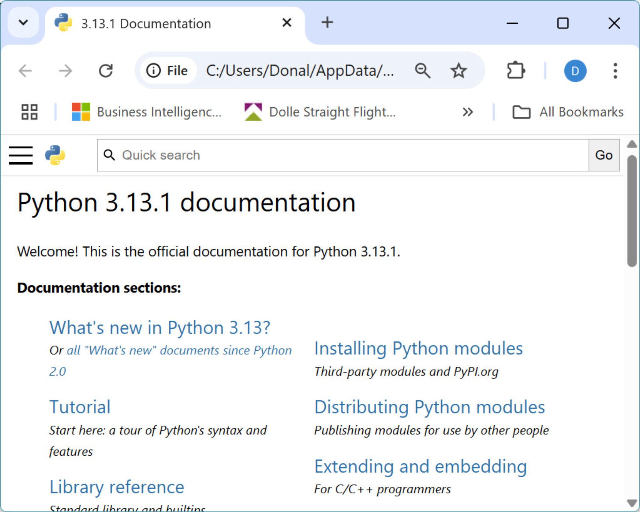
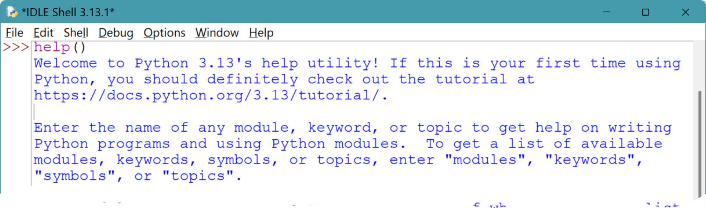
Python Help
IDLE – Press <F1> for help
Online Help
http://docs.python.org
http://docs.python.org/lib
UNIX/Linux man pages
Python pydocs
Python Shell – Interactive help()
$ man python
C:\ pydoc sys
Notes:
Python documentation is readily available online. For example, the module reference can be found at:
http://www.python.org/doc/current/lib/modindex.html
And the Python 3 language reference is available at:
http://docs.python.org/3.0/
IDLE includes built-in access to documentation, and on UNIX/Linux systems, man pages are typically bundled (try man -k python to explore extensions).
The pydoc tool is a handy way to view documentation from the command line:
On UNIX/Linux: run pydoc module_name, e.g., pydoc sys
On Windows: use pydoc.py located in the Lib folder, e.g.,C:\Python32\Lib\pydoc.py sys
Windows releases often include a Tkinter-based GUI version of pydoc (usually in the Tools folder), though you may need to create a shortcut for easy access.

Slide 21
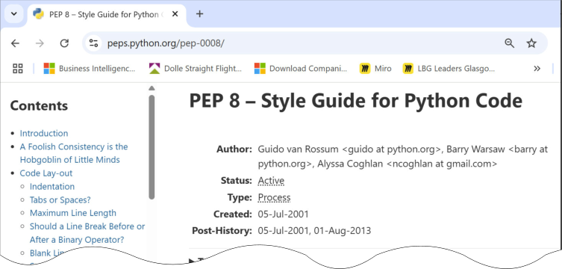
PEP – Python Enhancement Proposals
Language design document
Evolution, Information and New features
PEP 8 – Style guide for Python
https://peps.python.org/pep-0008/
Code layout
Readability
Consistency
Indentation
four spaces!
Dos and don’ts
‘Code is read much more often than it is written.’ - Guido Van Rossum
Notes:
Python Enhancement Proposals (PEPs) are design documents that outline the evolution, features, and key decisions behind the Python language. They serve as a communication tool for the Python community, explaining the rationale for new features, when they were introduced, and how they were implemented.
The comprehensive index of PEPs can be found at:
http://www.python.org/dev/peps/
They are also included in the Python 3 documentation, with many help texts linking directly to relevant PEPs.
One of the most important PEPs is PEP 8, the official Style Guide for Python Code. It defines best practices for code layout, readability, consistency, and overall coding conventions. PEP 8 should be read, followed, and referenced frequently to write clean and maintainable Python code.

Slide 22
Anatomy of a Python Script
#!/usr/bin/python
# Example Python script
import sys
argc = len(sys.argv)
if argc > 1:
print('Too many args')
else:
where = 'World'
print("Hello", where)
print('Goodbye from ' +
sys.argv[0])
She-bang line for Unix/Linux, ignored in Windows
Comment line
Load external module
Variable assignment and function call
Condition terminated by a colon ‘:’
Condition terminated by a colon ‘:’
Condition terminated by a colon ‘:’
Statements are terminated by a new-line unless inside brackets. Note the + used to join strings
Notes:
When a Python script is executed, the code is first compiled into bytecode and then run—similar to languages like Java and C#. This compilation step is fast and usually not noticeable. All the lines shown are optional, and this example omits details such as function definitions and global variables.
The first line, often called a shebang, tells UNIX which interpreter to use. It begins with #, which is also a comment—so on Windows systems, it’s ignored.
The import statement loads an external module. This is typically placed near the top of the script. In this case, sys is imported to provide access to system-specific parameters and functions. We’ll cover modules in more detail later.
A variable assignment is shown without explicitly declaring a type—Python handles typing dynamically. The if condition ends with a colon, and code blocks are defined by indentation. This rule applies to all control structures, including loops. The print() function outputs text to the standard output stream (STDOUT), usually the terminal, and adds a new line by default.
Most Python statements end with a new line. But if a new line appears within brackets, it’s treated as whitespace. You can also escape a new line using a backslash (\). Technically, you can put multiple statements on one line separated by semicolons—but just because you can, doesn’t mean you should. But we can C what you are doing and will disapprove!

Slide 23
Modules
Most Python programs load other Python code
Standard Library modules bundled with Python
Downloaded or modules written locally
Import with and without Namespace prefix:
Examples:
os: Operating system specific code
sys: Interface to the runtime environment
NumPy, DISLIN, SciPy: Scientific libraries
“builtins”: Python's built-in functions (automatically imported)
>>> import sys
>>> print(sys.platform)
>>> from sys import *
>>> print(platform)
>>> help("builtins")
Notes:
Each module has its own namespace, so variables and functions defined within one won’t interfere with those in another, even if they share the same name.
Python comes with a rich set of built-in modules, and they are used frequently. A list of standard modules can be found in the online documentation. Additional modules can be downloaded from https://pypi.org/ - check the sidebar for those specifically compatible with Python 3.
Python locates its modules from directories listed in the PYTHONPATH environment variable, or from its built-in lib directory.
To view help for a module in IDLE, type help(module_name), or enter help() to access the help prompt. From there, type modules to see a list of available modules, and then enter the name of a module for detailed documentation.
We’ll also explore how to create our own modules later on.

Slide 24
Function and builtins
A function is a named block of program code
It can be passed values, which might be altered and can return a value
We can write our own functions
Python includes many built-in functions in the compiler
Called (remarkably) builtins or __builtins__ and viewed as a module
Always available - no need to import
Examples: print(), len(), str(), list() and set()
See the online documentation
The Python Standard Library > Built-in Functions
Summary list at the end of this chapter
lhs = function_name(arg1, arg2,…)
Notes:
Functions are blocks of code designed to perform specific tasks. Python includes many built-in functions that significantly enhance the language's capabilities. These functions are always available—they don’t require any external modules to be imported—and execute very efficiently.
While a list of common functions is provided at the end of this chapter, the most comprehensive and up-to-date reference is the official Python documentation.
To view the full list of built-in functions directly in Python, use:
>>> help(“builtins”)
>>> help(__builtins__)

Slide 25
Review & Lab
Answer review questions
Your instructor will guide you which lab exercises to complete

Slide 26
Review Questions
Which of the following is NOT a valid way to run a Python program?
From the command line as a script
Interactively via the REPL
Using an IDE like VSCode or PyCharm
Compiled as a .java file
What does the import statement in Python do?
Compiles the script into machine code
Loads a built-in function into memory
Imports an external module into the program
Executes the main function of the script
Notes:
Answers on next page..

Slide 27
Review Questions
Why is proper indentation important in Python?
It helps the compiler optimize the code
It is required to define code blocks
It improves speed and memory usage
It’s only needed for comments
Which of the following is true about Python’s built-in functions?
They must be imported from external modules
They are slow and memory-intensive
They are available by default and run quickly
They require internet access to use
Notes:
Correct answers:
Which of the following is NOT a valid way to run a Python program?
Compiled as a .java file.
Explanation: Python is not compiled as .java files. It is interpreted and can be run from scripts, interactively, or via IDEs.
What does the import statement in Python do?
Imports an external module into the program
Explanation: The import statement is used to bring external modules or libraries into your Python program.
Why is proper indentation important in Python?
It is required to define code blocks
Explanation: Python uses indentation to define blocks of code (e.g., for loops, if statements, functions). It’s a core part of the language syntax.
4. Which of the following is true about Python’s built-in functions?
They are available by default and run quickly
Explanation: Built-in functions like print(), len(), and type() are always available in Python and are optimized for performance.

Slide 28
Summary
Python is a fully functional, free programming language
Extensive online documentation is available
Python scripts can be run:
As standalone scripts
Interactively via the REPL
From an IDE like VS Code or PyCharm
Python’s syntax is unique and whitespace-sensitive
Proper indentation is required — by design!
External modules are commonly used
Load them with the import statement
Built-in functions are:
Fast, always available and very useful

Slide 29
Python Builtin Functions (page 1 of 2)
fn_name(args) | fn_name(args) | fn_name(args)
abs(x) | bytearray([arg[, encoding[, errors]]]) | dir([object])
all(iterable) | bytes([arg[, encoding[, errors]]]) | divmod(a, b)
aiter(iterable) | callable(object) | enumerate(iterable[, start=0])
any(iterable) | chr(i) | eval(expression[, globals[, locals]])
anext(iterable) | classmethod(function) | exec(object[, globals[, locals]])
ascii(object) | compile(source, filename, mode[, flags[, dont_inherit]]) | filter(function, iterable)
bin(x) | complex([real[, imag]]) | float([x])
bool([x]) | delattr(object, name) | format(value[, format_spec])
breakpoint(function) | dict([arg]) | frozenset([iterable])
Notes:
This slide, and the one which follows, is meant for reference - you are not expected to remember these! You will probably only regularly use about a quarter of them anyhow - not many experienced Python programmers could produce this list from memory.
This is not a substitute for the main online documentation.

Slide 30
Python Builtin Functions (page 2 of 2)
fn_name(args) | fn_name(args) | fn_name(args)
getattr(object, name[, default]) | isinstance(object, classinfo) | min(iterable[, args...], *[, key])
globals() | issubclass(class, classinfo) | next(iterator[, default])
hasattr(object, name) | iter(o[, sentinel]) | object()
hash(object) | len(s) | oct(x)
help([object]) | list([iterable]) | open(file[, mode='r’[,buffering=None [, encoding=None[, errors=None [, newline=None,closefd=True]]]]]])
hex(x) | locals() | ord(c)
id(object) | map(function, iterable, ...) | pow(x, y[, z])
input([prompt]) | max(iterable[, args...], *[, key])
int([number | string[, radix]]) | memoryview(obj)

